Slide 1
NHS PAM Electrical Systems
2nd June 2016

Slide 2
1) Policy & Procedures
Does the Organisation have a current, approved Policy and an underpinning set of procedures that comply with relevant legislation and published guidance?

Slide 3
1) Policy & Procedures - Evidence
Policy applies to all parts of the Trust Estate and personnel as well as to any other person who may come into contact with Electrical Systems and Equipment whilst on any Trust premises.
It may include: -
High Voltage Distribution
Low Voltage Distribution
Fixed Electrical Equipment and Plant
Portable Electrical Equipment

Slide 4
2) Roles & Responsibilities - Evidence
Policy defines responsibilities for the duty to manage the Trust’s health and safety arrangements relating to Electrical Systems and Equipment.

Slide 5
Electrical Structure
(HTM06-02)
Executive Manager
Designated Person
Authorised Person
Authorising Engineer
(External Consultant)
Competent Person
(External Contractors)
Competent Person

Slide 6
3) Statutory Requirements and Guidance
Has there been a review of all relevant Statutory requirements and guidance, a risk assessment undertaken and any necessary risk mitigation strategies applied and regularly reviewed?

Slide 7
3) Statutory Requirements and Guidance - Evidence
Technical and performance guidance is set out in the latest Health Technical Memorandums (HTM’s) and British Standards.
New standards may not be retrospective and as such may not apply to systems which were designed to older standards. A risk assessment based methodology shall be required where this applies.

Slide 8
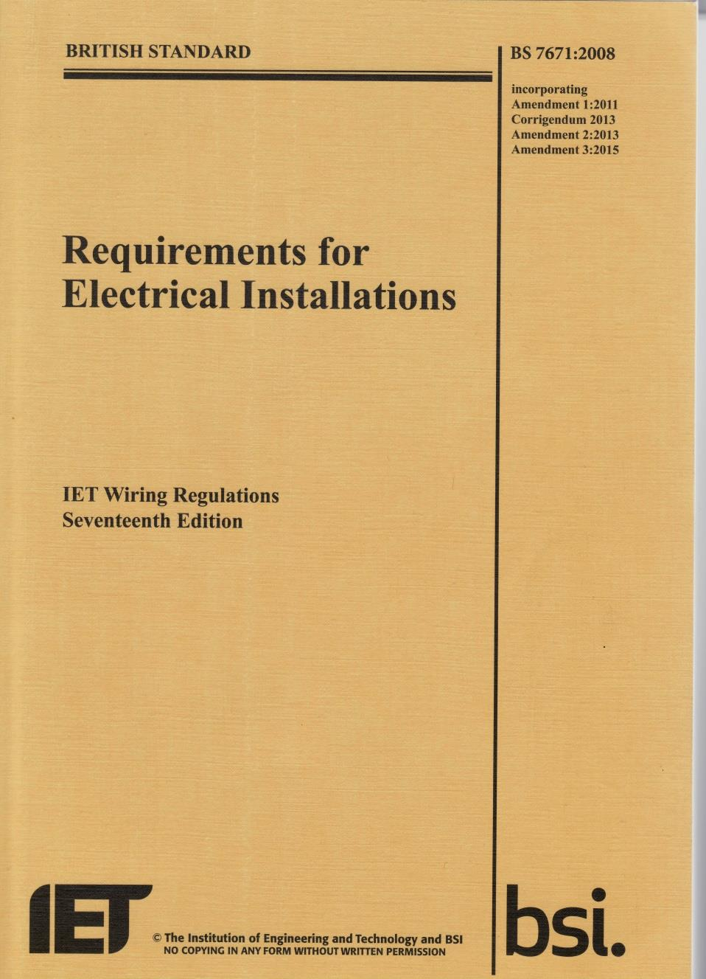
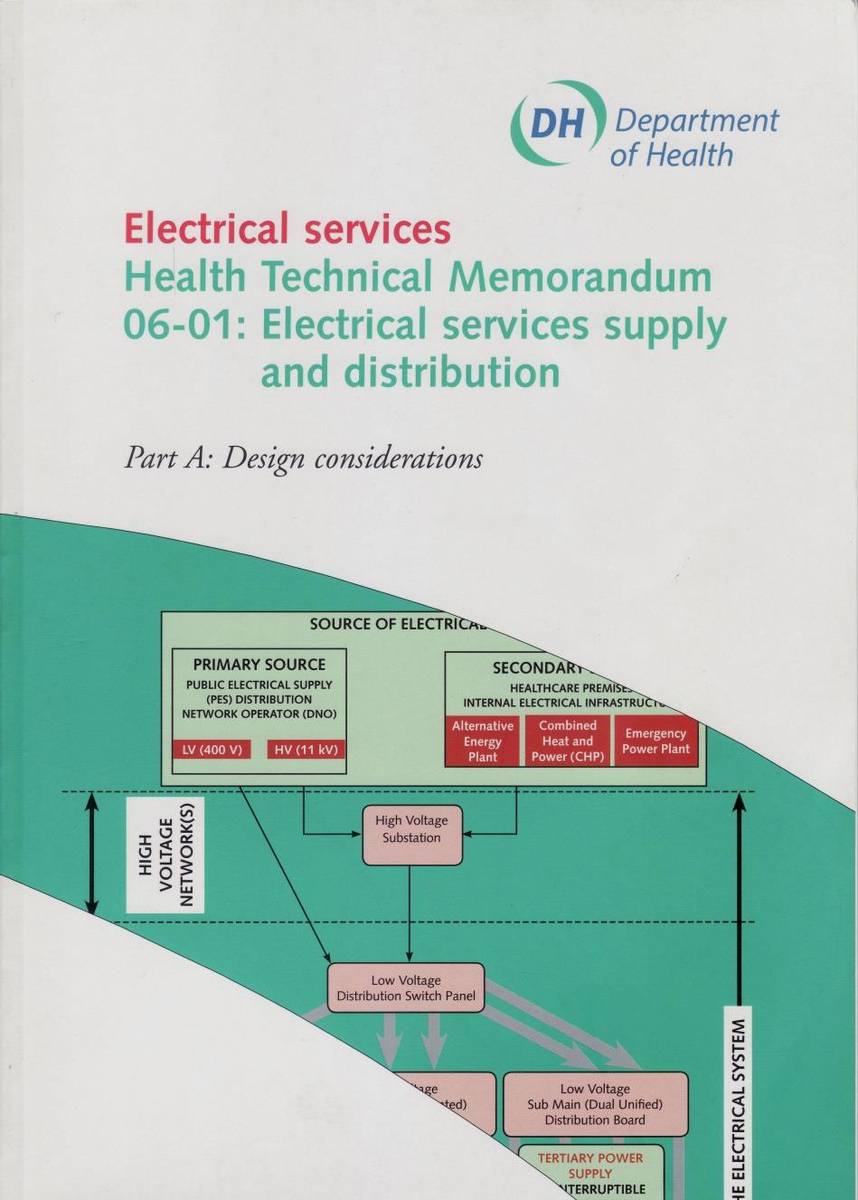
Statutory Requirements & Guidance

Slide 9
Example Electrical Inspection & Testing Regime (HTM06-01 Part B)
Location | Recommended Maintenance Activities
 | non-invasive visual inspection | Non-intrusive functional test | Inspection & Test | Thermographic Survey
High-voltage switchgear and protection | 6 months | - | tba | 1 years
High-voltage earthing | 1 years | - | 3 years | 1 years
Transformers | 1 years | - | tba | 1 years
Low-voltage switchgear and protection - Main Intake | 6 months | - | - | 1 years
Low-voltage switchgear and protection - Distribution Centres |  | - | - | 1 years
Low-voltage earthing | 6 months | - | 2 years | -
Generators - PV Solar | 1 years | - | 1 years | -
Generators - Combined Heat & Power | 1 years | - | 1 years | -
Generators - Standby Diesel | 1 week | 3 months | 1 years | -
Electromagnetic compatibility | - | - | 5 years | -
Lightning Protection System | 6 months | - | 13 months | -
Cable containment | 12 months | - | - | -
Busbars & Cables | 12 months | - | 10 yearly | -
Uninterruptible power supplies, inverters and batteries | - | 6 months | 6 months | -
Isolated power supplies | - | 6 months | 6 months | -
Harmonic Filter | Not installed
Power-factor correction units | 12 months | 12 months | 5 years | -
Final Circuits - Low Risk Areas | 6 months | 12 months | 5 years | -
Final Circuits - High Risk Areas | 6 months | 6 months | 3 years | -
Portable appliance testing | user | 18 months | by assessment no greater 48 months | -

Slide 10
4) Maintenance, Record Keeping and Asset Register
Are assets, equipment and plant adequately maintained with all relevant records (maintenance manuals, procedures, test certificates, etc.) available, up to date and kept in an appropriate manner including, where relevant, an up to date asset register?

Slide 11
4) Maintenance, Record Keeping and Asset Register - Evidence
List of assets;
Up to date drawings of electrical infrastructure;
Evidence of Planned Preventative Maintenance; and
Effective maintenance contracts with contractor management.

Slide 12
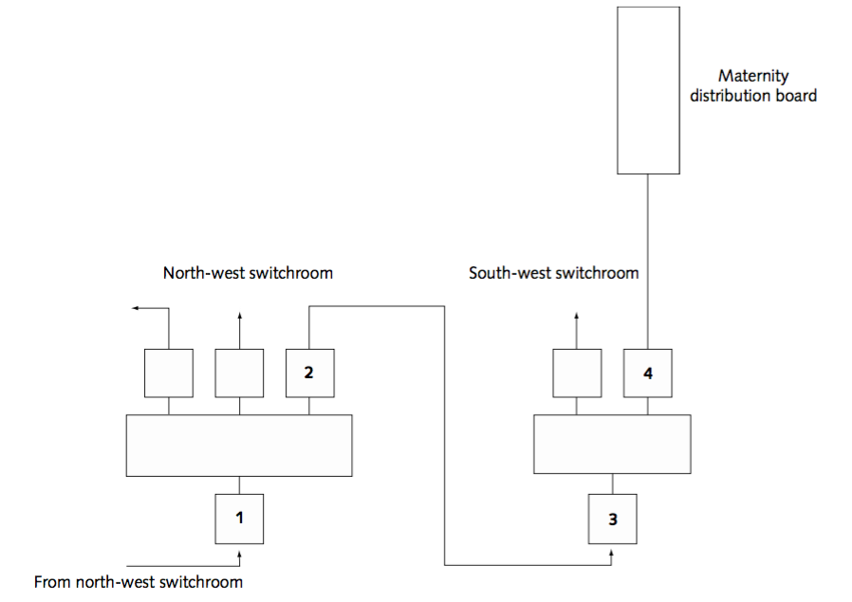
Example Network Drawing
(HTM06-02)

Slide 13
Example Maintenance Worksheet

Slide 14
Example Maintenance Worksheet

Slide 15
5) Training
Does the Organisation have an up to date training plan in place covering all relevant roles and responsibilities of staff, that meets all safety, technical and quality requirements?

Slide 16
5) Training - Evidence
Electrical policy defines the training requirements;
Certificates of appointment for AP’s and CP’s should be reviewed on a regular basis; and
Authorising Engineer should review on an annual basis.

Slide 17
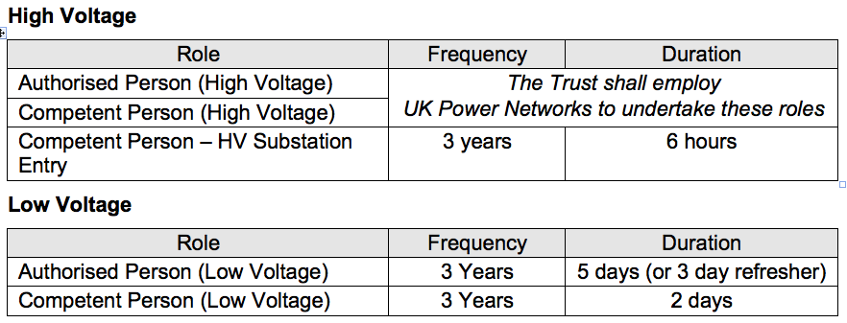
Training - Evidence

Slide 18
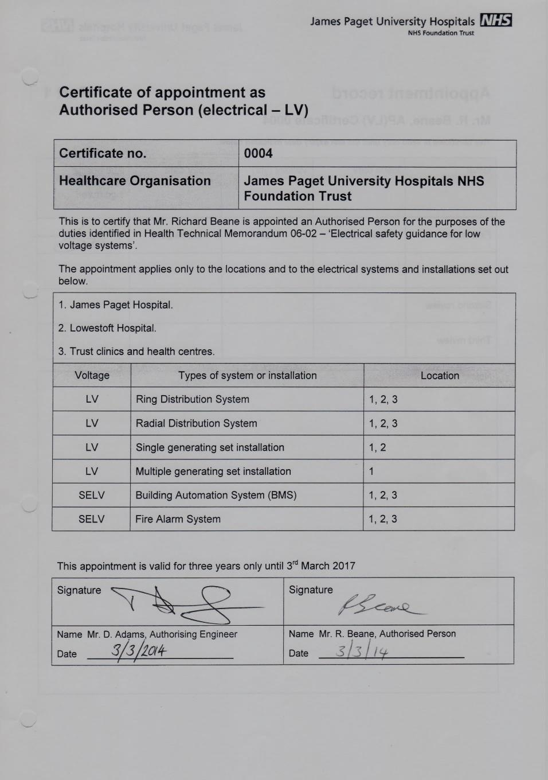
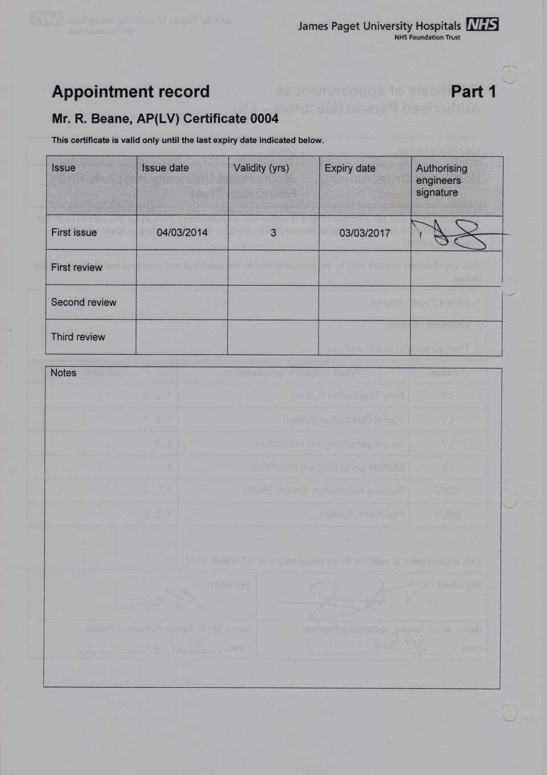
Training - Evidence

Slide 19
6) Building and Maintenance work
Where building and maintenance work impacts on existing systems are risk assessments undertaken and the work designed, undertaken and commissioned to the appropriate standards.

Slide 20
6) Building and Maintenance work - Evidence
Contractors Risk Assessments & Method Statements;
Trust checks to ensure Contractors employees are competent (e.g. CP(LV) certificates);
Constructionline company registration check.
Permits-to-work; and
Evidence of inspection and testing certificates.

Slide 21
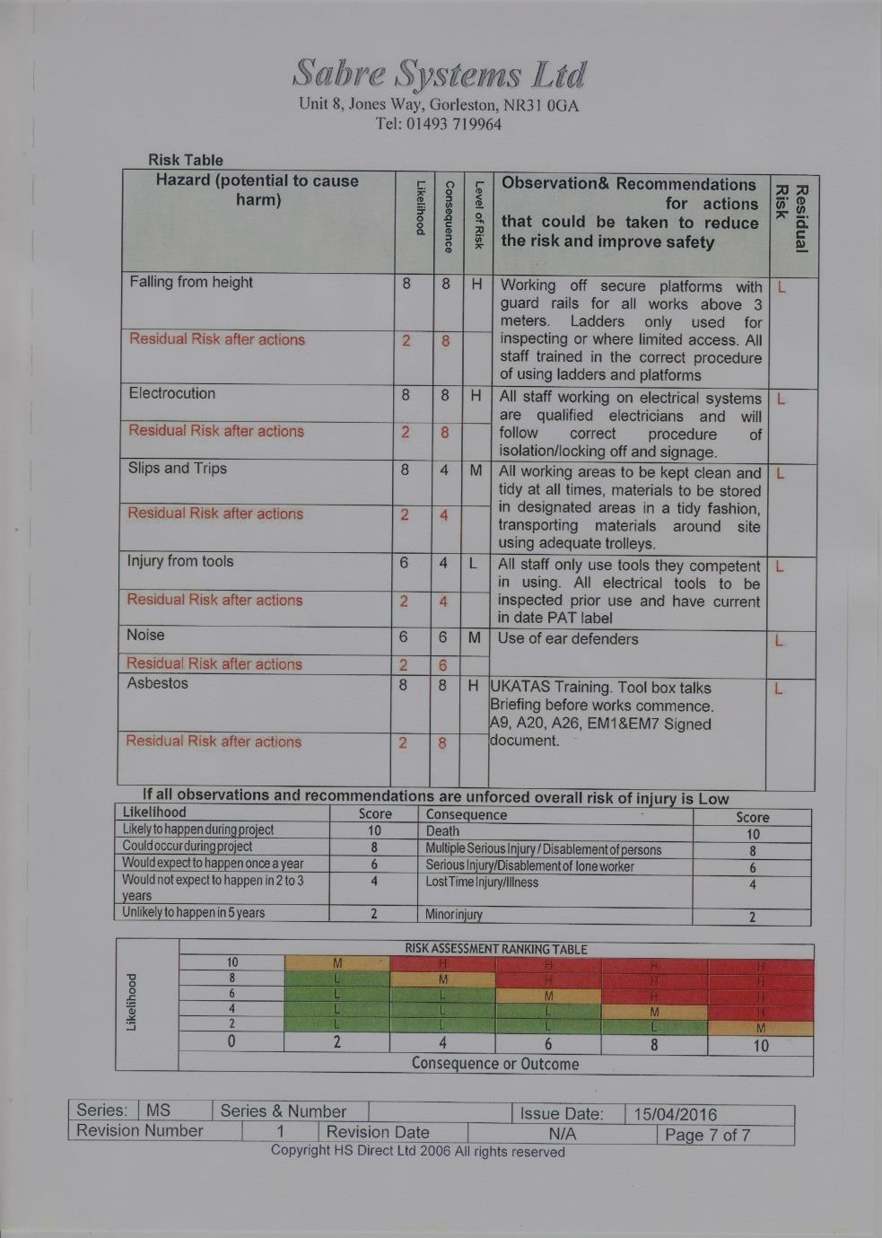
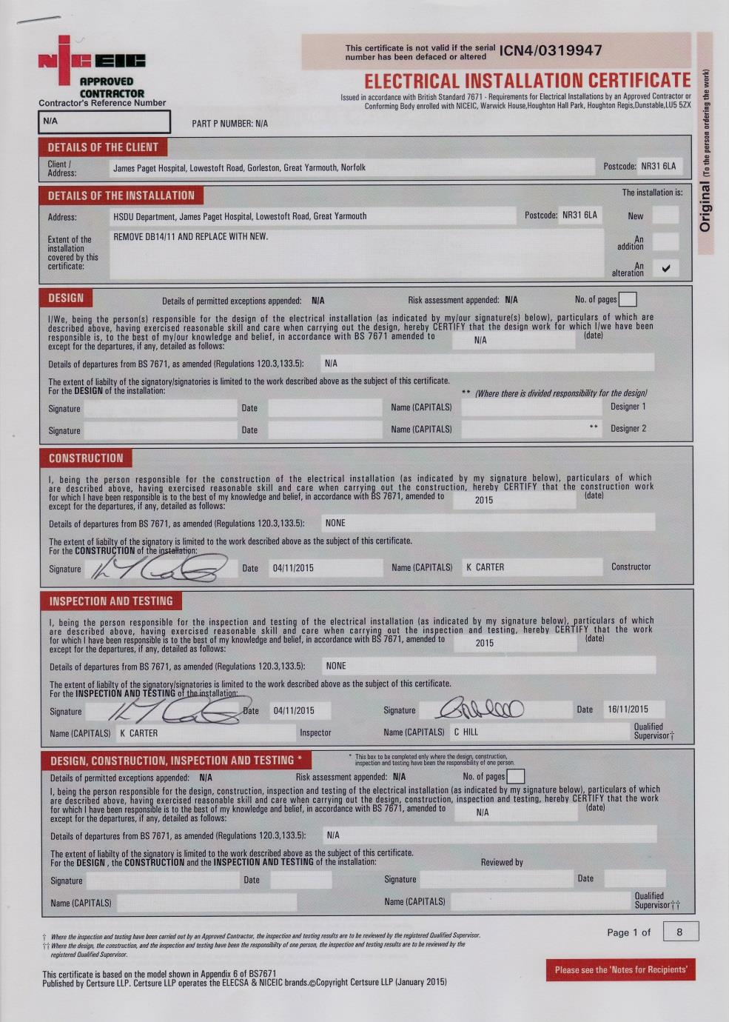
Example Contractors Risk Assessment &
Installation Test Certificate

Slide 22
7) Resilience, Emergency & Contingency Planning
Does the Organisation have resilience, emergency, contingency and escalation plans which have been formulated and tested with the appropriately trained staff?

Slide 23
7) Resilience, Emergency & Contingency Planning - Evidence
Emergency Plans (e.g. on-call action cards)
Lists of all standby equipment (e.g. Generators, Central UPS, Local UPS, Theatre Light Battery Backups, Nurse Call Battery Backups, Emergency Lighting, etc.).
Evidence of testing the equipment and training.

Slide 24
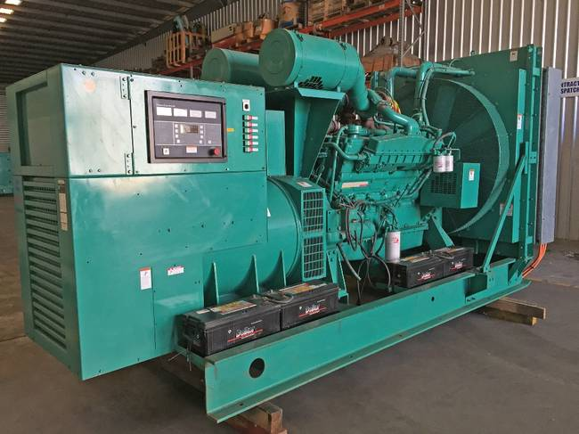
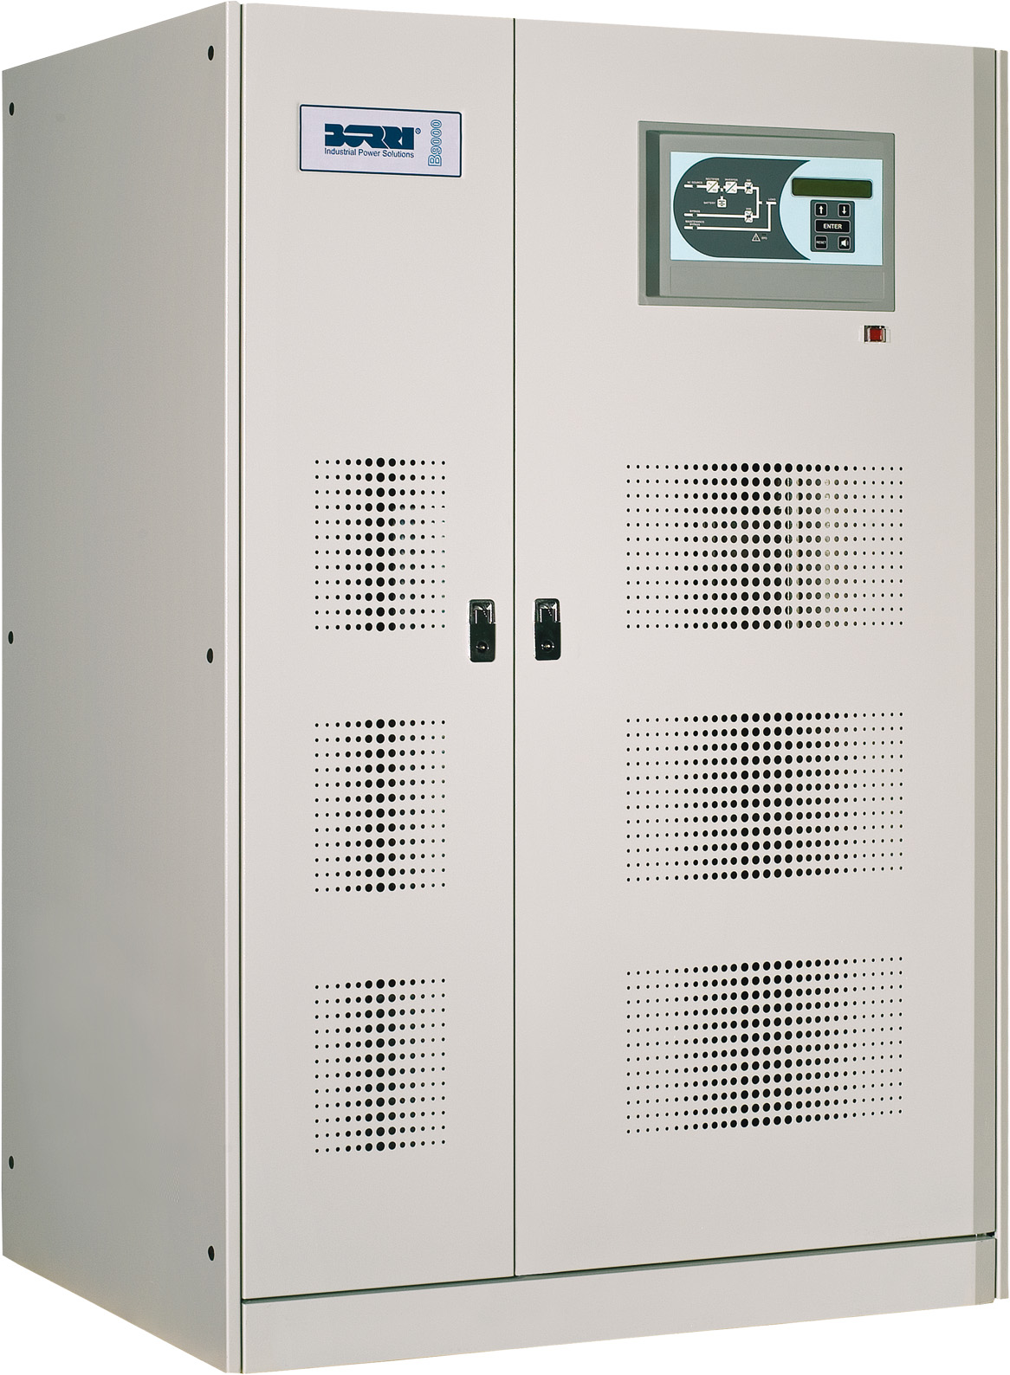
Example Standby Equipment

Slide 25
Example List of Standby Equipment

Slide 26
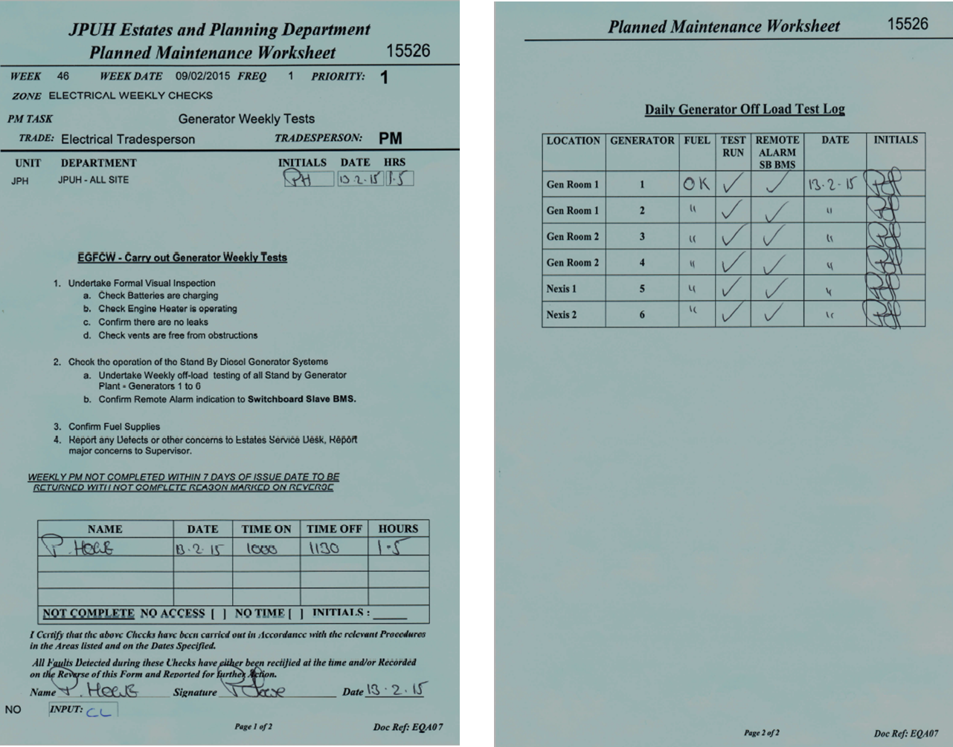
Example Maintenance Worksheet

Slide 27
8) Review Process
Is there a robust annual review process to assure compliance and effectiveness of relevant standards, policies and procedures?

Slide 28
8) Review Process - Evidence
Appointment of an Authorising Engineer;
Internal checks on staff training;
Review planned preventative maintenance data; and
Maintenance contracts (e.g. are recommendations from service visits actioned?)

Slide 29
9) Action Plans
If the organisation/site has any inadequate or requires (moderate or minor) improvement ratings in this SAQ, are there risk assessed action plans in place to achieve compliance?

Slide 30
9) Action Plans - Evidence
Electrical Strategy detailing priorities and five year plans;
Investment in backlog maintenance;
Defined standards for upgrade works; and
Risk register entries for areas of concern or non-compliance.

Slide 31
Example Action Plan

