Slide 1
Water Hygiene SH8
Lee Stuckey

Slide 2
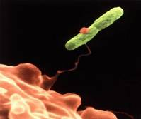
LEGIONELLA
37^{O}C grows well
2011 - 650 cases
Symptoms - head/muscle ache, dry cough, tightness to chest, sickness diarrhoea, confusion delirium, coma - death
Effects: hearing loss, amputation, immuno-compromised.
Only a risk if breathed in – aerosol
Sources – Showers, Water systems, dead leg pipe work cooling towers, spa pools, pressure hoses.

Slide 3
Legionella or Water Hygiene ?
Effects Policy
Primary legislation (Go to gaol’s) = HSWA + COSHH Regs + RIDDOR +MHSW Regs
L8 ACOP 4th Edition
BS8580 Water Quality Risk Assessments for Legionella control (within this BS7592 2008; ‘Sampling for legionella bacteria in water systems’ is referred.
HTM 04/01 Healthcare Technical Memorandum: The control of Legionella bacteria in water systems (parts A,B,)
Legionella Control Association (differing parts – check the accreditations for what you want)

Slide 4
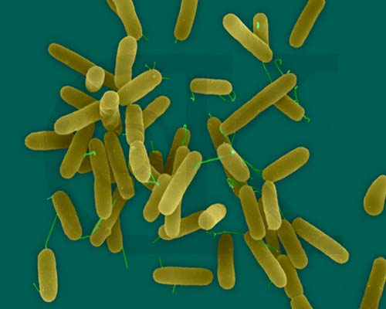
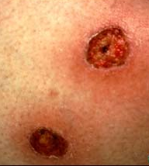
Pseudomonas aeruginosa
Wash your hands
Dry sink basin / tap
Neonates & immuno-compromised
Ecthyma gangrenosum

Slide 5
Water hygiene – other factors
Pseudomonas aeruginosa HTM 04/01 Healthcare Technical Memorandum: The control of Legionella bacteria in water systems (part C)
HTM 04/01 (part B) – guidance on measures to control
Pseudomonas aeruginosa Stenotrophomonas maltophilia, Mycobacteria as well as Legionella.
Stenotrophomonas – 14 species heat sensitive – does not grow above 40°C
Coliforms
TVC
Sterile services standards for water utilised for scope cleaning
Renal services clinical water hygiene standards
David Needs (health & safety advisor)
Kevin Chinnery (local security management specialist)

Slide 6
Roles and responsibilities
Statutory Duty Holder (as per ACOP L8) The person who is in control of premises or systems in connection with work, where there is a risk from systems in the building
Specialist contractor (Evolution) act as speciality engineer.
In house Responsible Person – Appointed (Head on Maintenance)
In house Authorised (Engineering) person (AP)
Authorised Engineer (AE)
Competent person (CP)
Water hygiene Committee DIPC representation (Infection Control Manager)
Assurance = Letter of appointment Responsible Person / Legionella Responsible person training certificate City and Guilds
accredited training undertaken January 2017
TOR and minutes of the ‘Water Hygiene Committee’

Slide 7
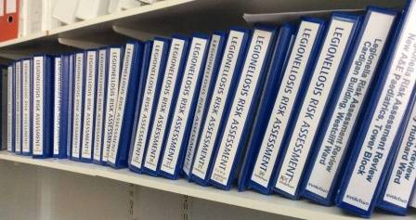
Risk Assessment
HSG 274 The assessment of risk is an on going process and not merely a paper exercise
COMPONENTS
Key findings summary / Defined scope / Included water systems / Identified key personnel / Competence and training records / Referred to or produced) schematic drawings / Condition Survey / Review of control scheme / prioritised recommendations – with reference to water safety plan / recommended specific control regime / when next to review/ Any limitations / Guidance on emergency procedures / matters beyond assessment scope / competence of assessor.

Slide 8
Maintenance
Eliminate – Prevent aerosol / prevent cross contamination
Control – Temperature / chlorine dioxide dosing / Ag Cu water treatment
Movement prevent stagnation / flush
Materials WRAS approved – by WIAPS accredited person
Cleanliness – keep it clean / process for cleaning best = separate tap / basin clothes disposable but costly for Pseudomonas
Contamination – prevention
RECORDS relating to:
CWS HWS tank inspection / calorifier draining / schematics updates / operating schedules of hot/cold water / Trust flushing record / WSP updates / log book updates / sampling records / Action plans and recommendations following elevated count results.

Slide 9
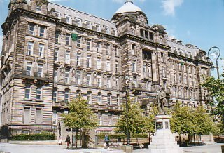
Training and Development
Not only what remember the why? 1986
Records relating to:
Responsible person accredited training (Usually City and Guilds)
WIAPS accredited plumber
In-house tool box talks
Specialist contractor competence training records

Slide 10
Resilience Emergency & Business continuity planning
The policy and procedures covers emergencies.
Contractor – Evolution contractual agreement includes confirmation for providers continuity plans and business resilience.
Trust contingency planning in place for EFM Services and wider Trust.
The organisation in its contingency planning undertake several agreed actions, such as locking down an area, implementing some form of business continuity or for a really large incident a significant incident would be declared (internal major incident).

Slide 11
Review process
RECORDS RELATING TO:
Sampling schedule
Sampling results
Actions upon finding elevated counts

Slide 12
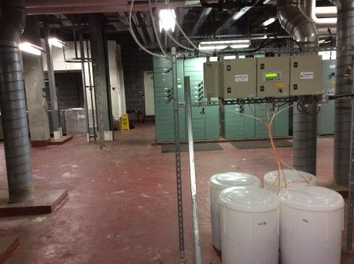
Costed action plans
Return loop projects
Calorifier adaptation
Externalisation of pipework
TMV removal and renew
Possible new technology project
Health safety input – eliminate work at height i.e. lower dosing equipment to plant room rather than handle chemicals up to tank
Merger opportunities to utilise joint contractual arrangements

