Slide 1
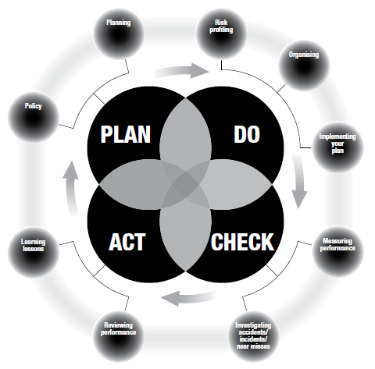
SH4: With regard to Health & Safety at Work can the organisation evidence the following?

Slide 2
Policy & Procedures Does the Organisation have a current, approved Policy and an underpinning set of procedures that comply with relevant legislation and published guidance?
Health and Safety Strategy
Health and Safety Policy
Policy statement
Policies to reflect National and European legislative requirements
Health & safety Committee
Incident reporting
Risk Management procedure
Acts / Regulations Must/Shall do
ACOP – Approved by HSE – If don’t follow need to find as good or better method
Guidance is just that (Including HTM , however if don’t follow need to find as good or better method)

Slide 3
Roles and Responsibilities Does the Organisation have appropriately qualified, competent and formally appointed people with clear descriptions of their role and responsibility which are well understood?
CEO appointment (Health and Safety Policy Statement endorsement)
Who in organisation is safety devolved to? (Head of Estates / Chief Nurse)
Named individuals – Responsible person / RPS / RPA /
Union Reps / First Aid qualified etc
Fire Officer IFE qualified / H&S (Chartered IOSH, BVSc MRCVS etc) / Environmental MIEMA
Attendance of Health and Safety Committee
Authorising Engineers / Competent Engineers
WIAPS authorised engineers to fulfil HTM 04-01 pipe alterations work etc

Slide 4
Risk Assessment Has there been a risk assessment undertaken and any necessary risk mitigation strategies applied and regularly reviewed?
Lofstedt = Reinforcement of the need for RISK BASED APPROACH
Environment (uncertain/dynamic)
Concurrent information – several sources
Shifting goals
Inferred/indirect indications
Immediate/multiple consequences
Time stress vs. periods routine
Human/technology interface
Differing priorities
Multiple differing professional interests
WARD ASSESSMENTS CAN BE HARD TO ENCOURAGE

Slide 5
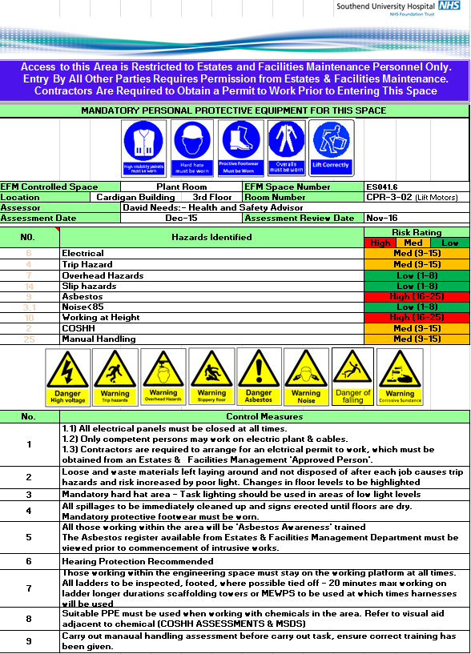
Risk Assessment Evidence
DSE / Lone Working / COSHH / Noise Assessments
/ Engineering Space Assessments
/ use of conventional sharps
Assessments from CAS alerts
Assessments from EFM projects
Water hygiene assessment]
Asbestos Management
Lift Insurance / maintenance assessments
Floor slip test assessments
Window safety assessments
Fire risk assessments

Slide 6
4: Maintenance Are assets, equipment and plant adequately maintained?
Asset registers equipment – MEMS
PPM schedules
Evidence of reactive maintenance
In service inspection LV electrical / Inspection of fixed wiring / HV systems
Air handling maintenance schedules
Generator inspection
Lift inspections
Renal / endoscope RO water plant service records
WIAPS certifications for pipework alterations
CAFM work task requests to meet PPM

Slide 7
5. Training and Development Does the Organisation have an up to date training and development plan in place covering all relevant roles and responsibilities of staff, that meets all safety, technical and quality requirements?
Safety training needs analysis records
Induction on going face to face safety presentations (Fire/H&S)
Learning and development
Tool box talks EFM specific issues
Specific safety associated presentation for risk tasks : Radiation / waste management / Gas safety / sharps safety / confined space / contractor control / Conflict Resolution /
EXTERNAL NEBOSH certificate / Diploma / Institute of Noise / IOSH Managing Safety / Inst. Occupational Hygiene
Union Reps safety course qualifications

Slide 8
6: Resilience, Emergency & Business Continuity Planning Does the Organisation have resilience, emergency, business continuity and escalation plans which have been formulated and tested with the appropriately trained staff?
Meeting Emergency Preparedness, Resilience and Response (EPRR)
Business Impact Assessments
Action cards SSD/MEMS/Accommodation/Soft FM/ Hard FM/
Documentation / Records associated with:
Exercising
Hazardous Materials (HAZMAT) and Chemical, biological, radiation and nuclear (CBRN)
Infectious diseases
Local Health Resilience Partnerships (LHRP)
Pandemic influenza
Severe weather (including cold weather, heatwave and flooding)
Maps of England displaying geographical boundaries for NHS England, Public Health England (PHE), local health resilience partnerships and local resilience for a
Preparing for industrial action

Slide 9
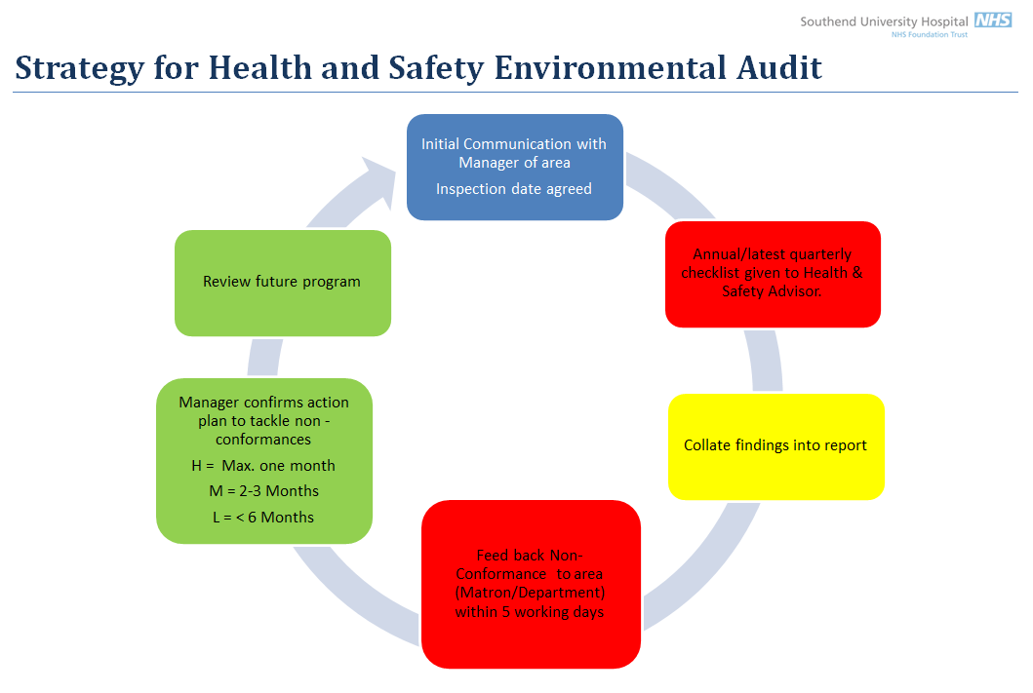
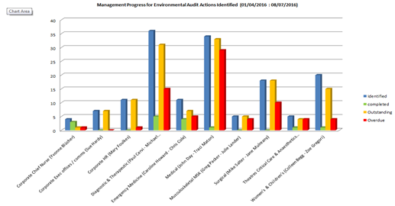
7: Review Process Is there a robust annual review process to assure compliance and effectiveness of relevant standards, policies and procedures?
Audit Strategy
Inspection / Audit Policy
Audit plan
Task log records
Action trackers

Slide 10
8: Costed Action Plans If any ratings in this SAQ are 'inadequate' or 'requires moderate or minor improvement' are there risk assessed costed action plans in place to achieve compliance? Costs can be entered below.
Business cases
Risk assessment action plans
CAS alert action plans

Slide 11
Continual improvement and beyond
System thinking approach focuses on whole dynamic of the system not just analysis of constituent parts.
Discontinuous improvement / encourage inspired approaches
‘Do things right or do the right thing’ can be difference between efficiency and effectiveness.

