Slide 1
Premises Assurance Model 2014 version SAQ S15 – Safe and compliant with well managed systems in relation to: Fire safety 2016 version SAQ SH14: With regard to Fire Safety can the organisation evidence the following?
Jason Bolton
Compliance Officer

Slide 2
Can you provide evidence to satisfy the PAM criteria?

Slide 3
If the answer is NO then you are Non Compliant to an Article of the Regulatory Reform (Fire Safety) Order 2005

Slide 4
Policy & Procedures
Does the Organisation have a current, approved Policy and an underpinning set of procedures that comply with relevant legislation and published guidance?
Article 11 of the RR(FS)O 2005

Slide 5
Evidence
Fire strategy
Fire policy

Slide 6
2) Roles and Responsibilities
Does the Organisation have appropriately qualified and formally appointed people with clear descriptions of their role and responsibility which are well understood?
Article 18 of the RR(FS)O 2005

Slide 7
Evidence
Fire strategy
Fire policy
Job descriptions
Qualification certificates
Letters of appointed Authorised Persons

Slide 8
3: Risk Assessment Was previously Statutory requirements and guidance
Has there been a risk assessment undertaken and any necessary risk mitigation strategies applied and regularly reviewed?
Article 9 of the RR(FS)O 2005

Slide 9
Evidence
Fire strategy
Fire policy
Internal Audits
External Audits
Risk assessments
Fire service visits

Slide 10
4) Maintenance Was previously Maintenance, Record Keeping and Asset Register
Are assets, equipment and plant adequately maintained?
Article 17 of the RR(FS)O 2005

Slide 11
Evidence
Fire hydrant testing records
Fire extinguisher maintenance records
Fire suppression maintenance records
PPM log books
Facilities maintenance screen shots
Hose reel maintenance records?
Commissioning certificates of new systems

Slide 12
5)Training and Development Was previously Training
Does the Organisation have an up to date training plan in place covering all relevant roles and responsibilities of staff, that meets all safety, technical and quality requirements?
Article 21 of the RR(FS)O 2005

Slide 13
Evidence
Directorate training plan CPD training records and certificates Specific training Mandatory training Appraisals and PDP's Fire safety strategy Hard copies of training records held by Compliance officer and in putted on to OLM Fire response team training Defend in situ training Practical fire extinguisher training Vertical evacuation equipment training Fire extinguisher maintenance training
Evacuation drill records
Training matrix

Slide 14
6) Resilience, Emergency & Business Continuity planning Does the Organisation have resilience, emergency, business continuity and escalation plans which have been formulated and tested with the appropriately trained staff?
Article 11 of the RR(FS)O 2005

Slide 15
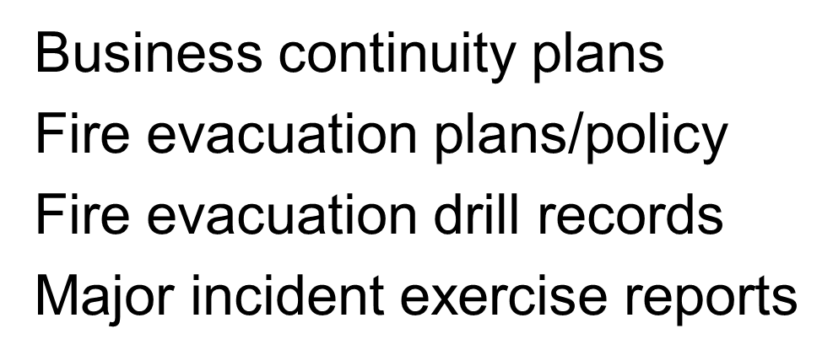
Evidence

Slide 16
S
7) Review process
Is there a robust annual review process to assure compliance and effectiveness of relevant standards, policies and procedures?
Article 11 of the RR(FS)O 2005

Slide 17
Evidence
Recorded in E&F governance/assurance report E&F governance structure E&F governance steering group minutes Annual PAM review Internal audit reports Internal fire audit from the Risk office External fire audits from SFRS

Slide 18
8) Costed Action Plans
Was previously action plans
If any ratings in this SAQ are 'inadequate' or 'requires moderate or minor improvement' are there risk assessed costed action plans in place to achieve compliance? Costs can be entered below.
Article 11 of the RR(FS)O 2005

Slide 19
Evidence
Pam action plan
Datix reports
Risk assessments

Slide 20
Any Questions ?

