Slide 1
BIRTH & BEYOND
WELCOME TO YOUR SESSION ON LABOUR & BIRTH
PROCESS OF LABOUR
PAIN RELIEF
WHEN TO GO TO HOSPITAL

Slide 2
STAGES OF LABOUR
1ST STAGE OF LABOUR: EFFACEMENT & DILATION OF THE CERVIX.
LATENT PHASE: IRREGULAR CONTRACTIONS/TIGHTENINGS. SHORTENENING OF THE CERVIX
ACTIVE PHASE: REGULAR, RHYTHMIC CONTRACTIONS FROM 4CM DILATED UNTIL 10CM.
2ND STAGE OF LABOUR: FROM 10CM DILATED UNTIL BIRTH OF BABY. PUSHING STAGE.
3RD STAGE OF LABOUR: DELIVERY OF PLACENTA

Slide 3

1st Stage
The 1st stage of labour is divided into 2 phases:
LATENT PHASE - The cervix is changing – softening, thinning, shortening
Irregular Contractions
Can Stop and start
Can last several days!!!!!!
Home is the best place at this time
Preparation: eating & drinking, being mobile
Distraction: bath, TENS
ACTIVE PHASE - cervix has dilated to more than 4cm.
Regular, rhythmic, (painful) contractions
Established labour to full dilation is usually between 6 and 12 hours

Slide 4
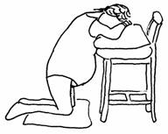
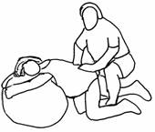

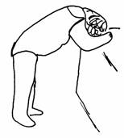

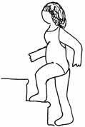
Positions for labour
Kneeling: relieves back pain & helps baby to rotate from back to back position
Walking; Standing & Leaning: helps stimulate effective contractions & works with gravity

Slide 5
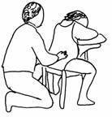
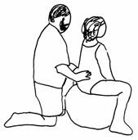
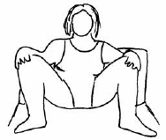
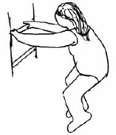

Sitting: allows rest between contractions
Squatting: opens pelvis to provide baby more room & aids gravity

Slide 6
2nd Stage
From 10cm dilated
Pushing stage
Can take up to 2 hours
Stretching of the perineum (area of skin between vagina and anus)
The midwife may ask you to stop pushing and breathe/pant or blow instead

Slide 7
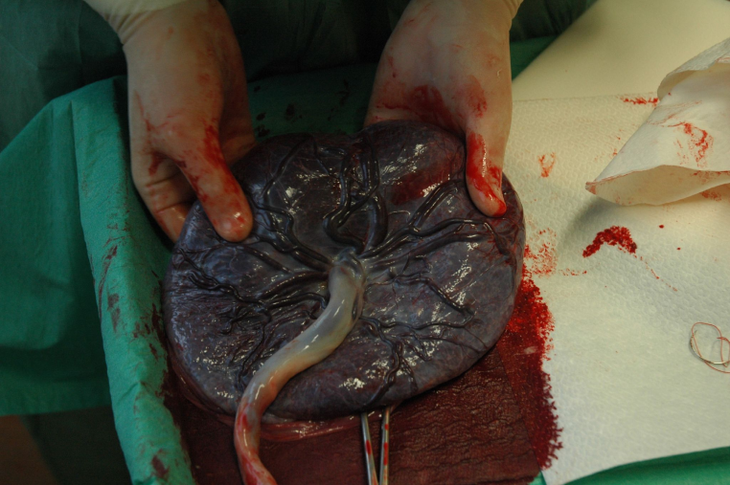
3rd Stage
Delivery of the placenta (afterbirth) and membranes (bag containing the waters and baby).
2 ways of delivering the placenta….
Physiological: immediate skin to skin with baby triggers hormones making womb contract. The midwife will watch for signs of separation and encourage woman to push out placenta.
NO PAIN!
Can take up to 1hour
Active: an injection called Syntometrine is given into thigh/bum. The midwife will watch for signs of separation and gently pull out the placenta.
Usually complete within 5-15minutes.

Slide 8
Hormone Cocktail
                OXYTOCIN
                ENDORPHINS
                ADRENALINE

Slide 9
Oxytocin
the love hormone – uterine contractions, bonding and natural euphoria.
Melatonin
works with oxytocin – together they accomplish more – works better in quite, dark settings and is inhibited by interruptions.
Endorphins
natures pain relief - light touch, massage, love & laughter.
Adrenaline
‘fight or flight’ – increases heart rate and breathing - released with bright lights, fear & stress, slows labour.

Slide 10

How exciting labour is approaching and you will soon meet your baby!
Imagine…………
Contractions (surges) are like waves – they ebb & flow (come and go)
Try to copy the rhythm of the waves…….
Breath in slowly and deeply as you visualise the wave rolling onto the shore
Pause your breath for a few seconds
- Slowly breath out as the wave rolls away from the shore
As a contraction begins RELAX, breath in deeply & slowly, then breath out slowly, continue breathing in & out slowly and deeply until the surge passes.
It helps if you close your eyes.

Slide 11
Pain Relief
Self-help techniques:
Breathing techniques
Massage
Alternative positions
TENS
Hydrotherapy (water):
Many women find water more relaxing able to cope with labour pain better without need for stronger pain relief
The water helps to support your weight

Slide 12
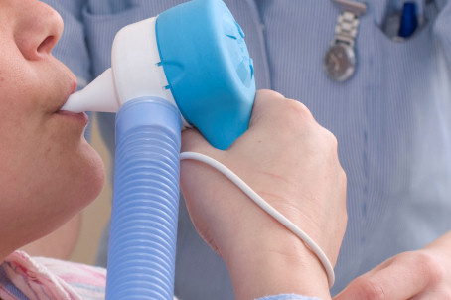
Entonox (Gas & Air)
A mixture of nitrous oxide and oxygen (Laughing Gas), which is inhaled through a mouthpeice during contractions.
Advantages:
You control how much gas you breathe in and how often it is taken
It can be used at any time during labour and alongside other pain relief methods
It has no harmful effects on baby
Disadvantages:
Some women feel dizzy, drunk, sick and/or out of control. However the effects wear off very quickly when you stop
breathing it
It has very short lasting effects. Some women
feel that it is not enough to help alleviate the
pain

Slide 13

Pethidine
Pethidine is a synthetic morphine like drug that can be given during labour by injection in the thigh/bum. Once given it takes about 15-20 minutes to become effective.
Advantages:
Pethidine can help you to feel more relaxed and comfortable. It may feel that the contractions become shorter
Disadvantages:
Occassionally women can experience disorientation and sickness. Pethidine is given alongside an anti-sickness drug
Like most drugs, Pethidine does cross the placenta and may make baby feel sleepy for the first 24hours. For this reason Pethidine is
not given to women near the end of their labour.

Slide 14
Epidural
A medical procedure carried out by an anaesthetist. The anaesthetist will explain the procedure and associated risks to you before carrying out the procedure. For an epidural you will need an intravenous drip to maintain your blood pressure.
Advantages:
An epidural will provide you with complete pain relief without causing complete numbness
It allows you to rest
Women with high blood pressure may benefit from an epidural as it lowers blood pressure
Disadvantages:
Your mobility will be limited, although you should still be able to move around the bed
Occasionally epidurals do not completely work and may need to be reinserted
You will need an IV drip and catheter in your bladder to drain the urine as you may not feel the need to go to the toilet
There is an increased risk of needing a Forceps or Ventouse delivery.
Very rarely there is a risk of infection and nerve damage.

Slide 15
Plans for birth…
It is always a good idea to have thoughts and ideas for your labour & delivery. The midwife will ask you your preferences/consent on the following things:
Pain relief
How you would like your placenta delivered?
Are you happy for Vitamin K for baby?
How are you going to feed baby?
Are you happy to have students present?
There is a section at the back of your handheld notes for you to jot down some of these thoughts.

Slide 16
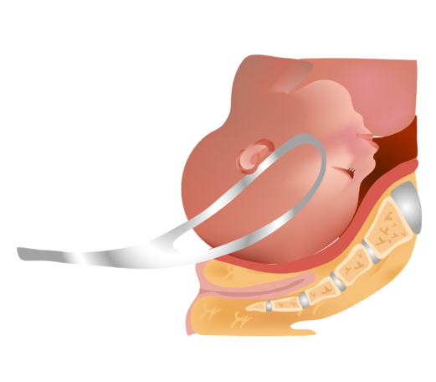
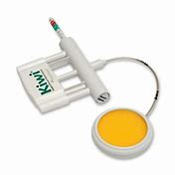
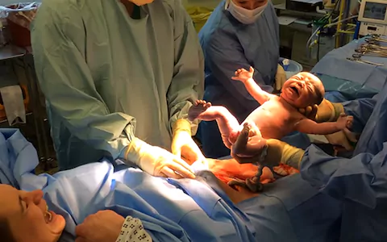
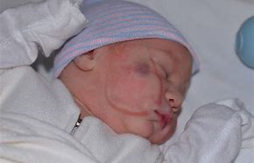
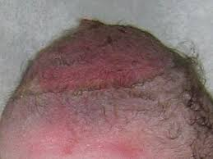
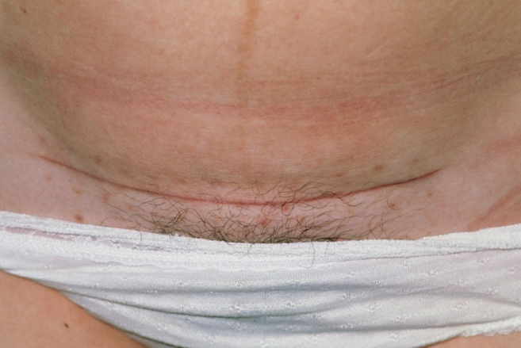
When things don’t go to plan…..
Forceps Ventouse Caesarean

Slide 18

As your baby’s birthday approaches …………

Slide 19

Initial time following birth
Dependant on type of delivery and delivery circumstances; baby or mum observations, stitches
Uninterrupted skin-to-skin time and help with breastfeeding.
Refreshments
Time alone with your baby
Shower/bath/wash
Early discharge home
Transfer to F11

Slide 20
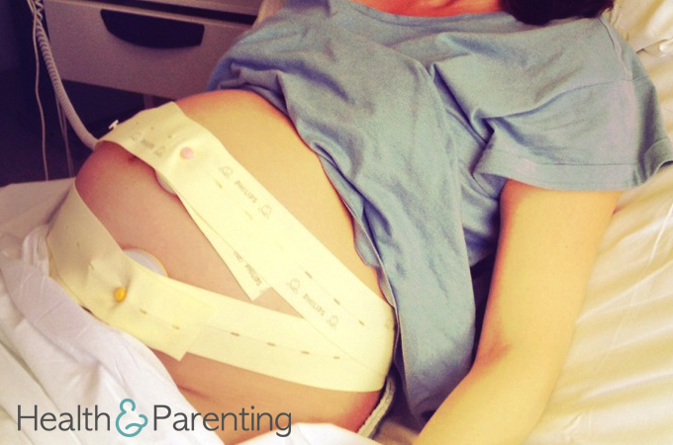
When to call the hospital…
If you feel a trickle or gush of fluid, with or without any pain
When you are experiencing contractions every 5 minutes, lasting 60 seconds, even if the pain is mostly/all in your back
If you feel a bearing down/pushing feeling in your rectum
If you’re concerned about baby’s movements
If you have a raised temperature and/or persistent cough

Slide 21
The End
Thank you for attending this session, we hope you have found it interesting.
☺

