Slide 1
Infant Feeding Workshop
Welcome
Infant Feeding Team
West Suffolk Hospital
June 2020

Slide 2
Welcome to our infant feeding information resource pack for you and your family. As you become a parent your behaviour is both instinctive and learned. Whilst some of you may have benefited from handling and caring for babies in the past, many will experience this for the first time when holding your baby following birth.
This resource is offered as one measure in supporting you to feed in a way that is both effective and responsive to the needs of your developing baby.
As you work through the following slides and video links please record any questions that you may wish to raise with your community midwife at your next discussion or meeting?

Slide 3
The aim of the package is to provide information to guide you in your choice and enhance your understanding of infant feeding. As you work through it you will have the opportunity to consider:
What are the benefits of breastfeeding and could it be for me?
What is responsive feeding and how do I prepare for this during pregnancy?
You and your baby immediately after birth and the use of skin to skin contact
How best to position your baby for a feed and ensure that attachment at your breast is effective
How to tell that feeding is going well
Expressing and storing colostrum and breastmilk
Challenges to breastfeeding

Slide 4
Why do health professionals recommend breastfeeding and breastmilk as the optimum choice for your baby?
The benefits of breastmilk are explained on the following NHS link
https://www.nhs.uk/conditions/pregnancy-and-baby/benefits-breastfeeding/
They include a reduced risk of infections and hospital admission for your child and for you the risk of breast/ovarian cancer and osteoporosis is lowered. For both of you, obesity and cardiovascular disease is less prevalent.
Follow this video for the thoughts of Tiny Human Productions: A creative collective of parents
https://vimeo.com/190696865

Slide 5
Breastmilk is cheaper and requires no preparation.
Your baby:
Receives immunoglobulins( antibodies that protect against infection) and microbes that colonise and protect the bowel (friendly bacteria) in the breastmilk
Is at reduced risk of ear, gastro-intestinal, chest and urine infections than a formula fed baby
Is at reduced risk of developing severe asthma and eczema
Benefits from feeding at the breast with improved speech and dental development
Learns how to moderate and interpret food, so is less likely to become obese or develop diabetes and more readily accepts weening foods.
In summary

Slide 6
Pregnancy: getting ready 1
Responding to your baby’s needs releases the love hormone Oxytocin that helps the development of nerve connections in the brain. Consider how you will meet these perhaps using those suggested below to start with?
Warmth
Food
Security
Love

Slide 7
Pregnancy: getting ready 2
Take time to relax and familiarise yourself with the pattern of your baby’s movements. Encourage your partner and your other children to become involved. Consider:
Playing music
Talking to your baby
Soothing and stroking in response to movements or kicks

Slide 8
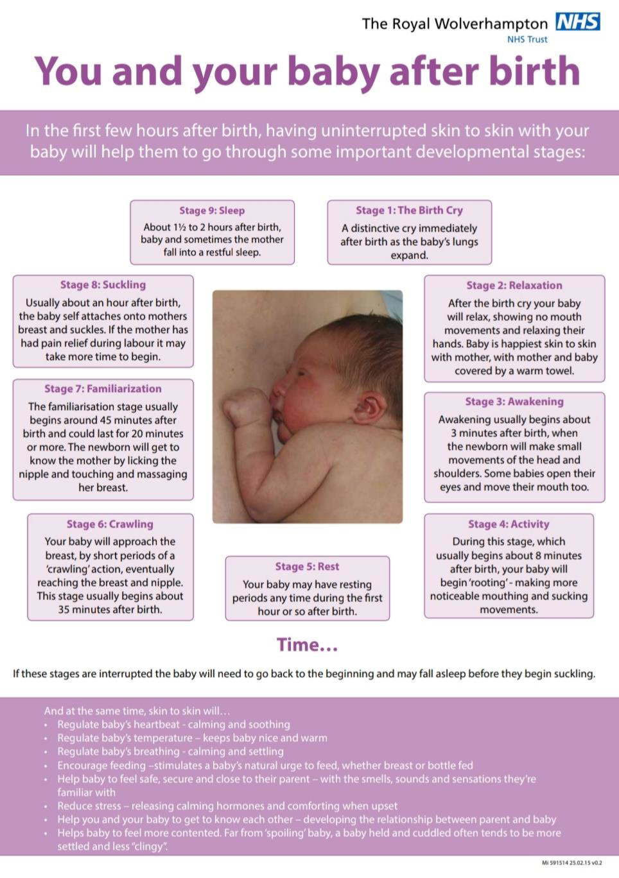
Getting feeding off to a good start
Skin to skin and first feed
Holding your baby in skin to skin after birth regulates temperature, heart rate and breathing. It helps your baby transition to life outside of your womb and provides opportunity for them to follow instinctive behaviours to seek out the breast and self attach to feed.
*If you have had a long or complicated labour and/or drugs used that have a sedative effect on your baby more skin to skin time and help attaching to your breast may be needed
The sheet to the left page is reproduced with permission of The Royal Wolverhampton NHS Trust. It shows the developmental stages your baby will go through immediately following birth. Note that the eighth of the nine stages suckling, or feeding, occurs upwards of an hour after birth*
Ask your midwife about the biological nurturing position which is useful in stimulating these stages.

Slide 9
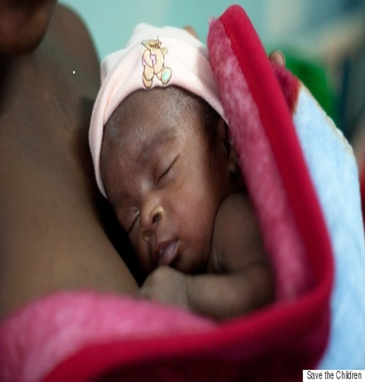
1.You are comfortable with refreshments to hand
2.Use skin to skin to assist feeding
4.Place your baby close(C) keep the head free(H) and the head and body inline(I) Finally line your baby up with their nose to your nipple(N) CHIN
3.Try a variety of feeding positions before you opt for the most comfortable but whichever you choose the principles are the same
5. Follow these principles and as you can see from the next slide your baby opens the mouth wide and the CHIN leads as you pull them into the breast
POSITIONING YOUR BABY FOR ATTACHMENT AT THE BREAST

Slide 10
POSITIONING YOUR BABY AND WHAT FOLLOWS
NOSE TO NIPPLE
WIDE OPEN MOUTH
CHIN LEADS
HEAD FREE/BODY IN LINE

Slide 11
How to tell that feeding is going well. Signs of effective attachment nose free, chin indents the breast and…….
Stays at breast
Satisfied after feed and content between feeds
Rounded cheeks
Curled bottom lip and more areola visible above upper lip
Long sucks regular short pauses
Feels comfortable for you after initial attachment

Slide 12
Check that feeding is going well. Does your baby
Have wet and dirty nappies as expected by age (see chart over page) ✓
At 3-4 days old and beyond audibly swallow frequently during the feed ✓
Feed for between 5 and 30 minutes at each feed 8-12 times over 24 hours ✓
Show no yellow discolouring of skin or eyes ✓
Finish the feed herself ✓
Appear generally calm and relaxed whist feeding and content after most feeds ✓

Slide 13
Pattern of wet and dirty nappies when breastfeeding is going well
The contents of your baby’s nappies will change during the first week. These changes will help you know if feeding is going well. Speak to your midwife if you have any concerns
Baby’s age | Wet nappies | Dirty nappies
1-2 days old | 1-2 or more per day urates may be present* | 1 or more dark green/black ‘tar like’ called meconium
3-4 days old | 3 or more per day nappies feel heavier | 2 or more, changing in colour and consistency – brown/green/yellow, becoming looser (‘changing stool’)
5-6 days old | 5 or more Heavy wet | 2 or more yellow; may be quite watery
7 days to 28 days old | 6 or more heavy wet | 2 or more at least the size of a £2 coin yellow and watery, ‘seedy’ appearance
*Urates are a dark pink/red substance that many babies pass in the first couple of days. At this age they are not a problem, however if they go beyond the first couple of days you should tell your midwife as that may be a sign that your baby is not getting enough milk. –see Mothers and others guide for further information

Slide 14
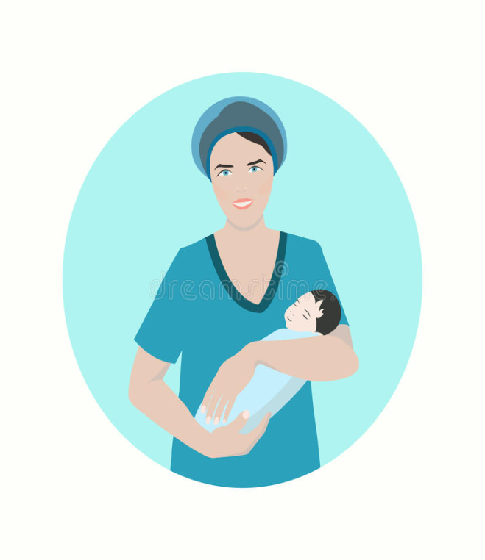
Your baby appears jaundiced (yellow discolouration of the skin)
Your baby is not having the wet and dirty nappies as explained
You think your baby needs a dummy or you feel you need to give your baby formula milk
Feeding frequently lasts for less than 5 minutes or more than 40 minutes
Your baby always falls asleep on the breast and/or never finishes the feed himself
You are having pain in your breasts or nipples, or post feed your nipple looks pinched or flattened on one side
Contact your midwife if ?
Most jaundice in babies is not harmful. It is important to check for any signs of yellow colouring usually appearing around the face and forehead, then body, arms and legs. A good time to check is when changing a nappy or clothes. Press your baby’s skin gently to see if you can see a yellow tinge developing. Check the whites of the eyes and the inside of his/her mouth to see if they appear discoloured

Slide 15
What if feeding doesn’t go well?
Reluctance to feed in your newborn will be carefully monitored in hospital and appropriate advice given. At home if your baby feeds fewer than 6 times in 24 hours, feeds for less than 5 minutes or more than 40 minutes regularly, or shows any of the behaviours shown on the previous slide please seek help immediately and offer skin to skin to prompt a feed.

Slide 16
Poor ineffective attachment at the breast
Prolonged and or frequent feeding
Trauma to mother and poor milk transfer to baby
Getting positioning and attachment right are important because
If you have any concerns or find that you or your baby’s experience does not meet your expectations please ask for early support from your midwife.
The next slide shows some of the more common examples of the effects of trauma or poor milk transfer

Slide 17
Sore, blistered or cracked nipples are often associated with ineffective attachment at the breast and a reduced milk supply to your baby
Excessive early weight loss, or faltering growth in the older baby weight loss of up to 8% in the first three days is normal
Mastitis makes your breast tissue inflamed and painful. A lump (this often comes before mastitis) and some redness around the area is common. More rarely the inflammation turns into an infection that gives flu-like symptoms or a fever. Using a variety of feeding positions can encourage the flow of milk from different areas of the breast and avoid blocked ducts and pooling of milk.
Link- NHS Your baby's weight and height
https://www.nhs.uk/conditions/pregnancy-and-baby/baby-weight-and-height/

Slide 18
Expressing breastmilk (colostrum) before your baby is born
When is it recommended?
Twins, elective caesarean section, diabetes, condition requiring anti- hypertensive treatment
When can I start?
You can start expressing from 36 weeks of your pregnancy
How often?
2-3 times a day for about 5-10 minutes from each breast
Superfact -Pregnant women start producing colostrum, or early milk, from around 20 weeks. It is rich in protein bio-available sugar and anti infective properties
How do I collect it?
We can provide you with 1 ml colostrum syringes
How do I store the milk?
If you are in one of the above groups ask for more information at your antenatal appointments
.

Slide 19
Collecting colostrum and breastmilk
Gently massage your breast and roll your nipple
Drawing the thumb and forefinger together gently compress for 2 seconds and release .Repeat until milk starts to flow. Expect a few drops, less than 1ml ,at first
Place thumb and fingers in a C shaped grip 2-3cm from the base of the nipple
Collect your milk in a sterile syringe or container, label with your name date of birth and date and time milk expressed. Store milk in the base or back of the freezer until needed. Previously frozen milk can be stored in the fridge for up to 24 hours.

Slide 20
Thank you for completing this pack. Please jot down any questions you have for your midwife for your next meeting or discussion.
If you and you baby are under the care of West Suffolk NHS Foundation Trust and you have a more urgent concern you can make contact as follows:
Monday– Friday 0900-1500
West Suffolk Hospital Community Midwives Hub
Phone 01284 713755 email-wsh-tr-communitymidwives@nhs.net
Out of Hours and Bank Holidays
F11 Phone 01284 712741
If you and your baby are under the postnatal care of a non WSH service contact please use the contact information given to you on discharge from hospital or by your community team midwife

Slide 21
Further Resources
MOTHERS & others GUIDE
NHS Breastfeeding: the first few days
https://www.nhs.uk/conditions/pregnancy-and-baby/breastfeeding-first-days/
Positioning and attachment Scottish Government
https://www.google.com/search?q=video+effective+positioning+and+attachment&rlz=1C1GCEA_enGB837GB853&oq=video+effective+positioning+and+attachment&aqs=chrome..69i57j33.9919j0j3&sourceid=chrome&ie=UTF-8
https://www.unicef.org.uk/babyfriendly/wp-content/uploads/sites/2/2020/04/Unicef-UK-Baby-Friendly-Initiative-statement-on-infant-feeding-during-the-Covid-19-outbreak.pdf
UNICEF UK BABY FRIENDLY INITIATIVE STATEMENT ON INFANT FEEDING DURING THE CORONAVIRUS (COVID-19) OUTBREAK Updated 14 May 2020
https://www.unicef.org.uk/babyfriendly/wp-content/uploads/sites/2/2020/04/Unicef-UK-Baby-Friendly-Initiative-statement-on-infant-feeding-during-the-Covid-19-outbreak.pdf

